Slide 1

HR Analytics

Slide 2

AGENDA :
Introduction & Objective
Business Objective
KPIs
Dashboard
Conclusion

Slide 3
Introduction
HR analysis leverages data to improve workforce management by identifying trends, optimizing talent strategies, and enhancing employee engagement. By analyzing metrics such as turnover, productivity, and diversity, HR analysis enables data-driven decision-making to foster a more effective and inclusive work environment.
Objectives
The objectives of HR analysis include enhancing employee retention by identifying turnover causes, optimizing recruitment and talent management processes, and improving overall workforce productivity. Additionally, HR analysis aims to support diversity and inclusion initiatives, monitor employee satisfaction, and ensure alignment of HR strategies with organizational goals.

Slide 4
Business Objective:
The aim of this project is to analyze employee retention and attrition rates with the organization and provide insights to the HR team for developing effective retention strategies. Through data analysis and visualizations, we will identify factors that contribute to :
Employee turnover and attrition.
Evaluate the effectiveness of existing retention strategies.
To verify the satisfaction level of employee in the organization.
Provide recommendations to improve employee retention.

Slide 5
Data Overview and Methodology
Data Overview:
Datasets:
HR_1: Contains Employee details like Educational field, department, Job role and hourly rate.
HR_2: Includes Employee history, monthly income, Number Of companies worked and Total working Years .
Methodology:
Data Preparation:
Data cleaning and integration from Excel and CSV sources.
Handling missing values and outliers.
Analysis Tools:
Excel: Initial data exploration and summary statistics.
Tableau & Power BI: Visualization of trends and patterns.
SQL: Data querying and transformation.

Slide 6
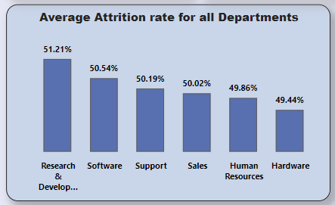
KPI 1 Average Attrition rate for all Departments
This KPI is to find out the relationship between each department and its attrition rate and here attrition rate is highest for Research & Development Department whereas lowest is for Hardware Department.
Insights from KPI 1:
We can clearly say that attrition rate of employees for every department is almost 50% which indicates that attrition rate of employees does not depends on department. So, irrespective of the department almost 50% of employees are leaving the company.
From this calculation and visualization we concluded that we must make strong strategies to minimize attrition rate and improve our company’s Employee retention so that we can balance the company’s growth and right talent.

Slide 7
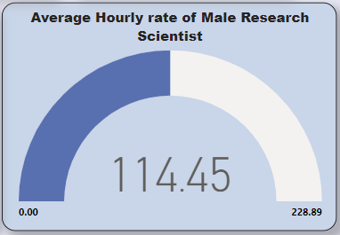
KPI 2 Average Hourly rate of Male Research Scientist
This KPI is to find out the Hourly rate for Job Role Research Scientist and for gender male.
Insights from KPI 2:
This KPI is to find out the average hourly rate of male research scientists which is 114.45.

Slide 8
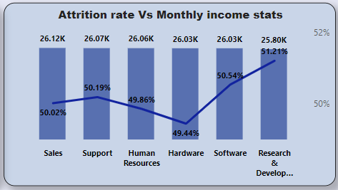
KPI 3 Attrition Rate Vs Monthly Income Stats
This KPI is to find out the relation the between monthly income and Attrition rate.
Insights from KPI 3:
Based on our analysis and visualization, it is evident that the Hardware Department has the lowest attrition rate of 49.44%, with an average monthly income of Rs. 26,091.20. On the other hand, the Research and Development Department has the highest attrition rate of 51.21%, with an average monthly income of Rs. 26,007.08

Slide 9
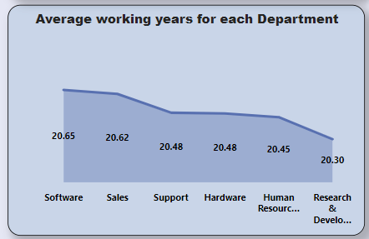
KPI 4 Average Working Years for each Department
This KPI is to find out the Average working years for each department.
Insights from KPI 4:
From this we can see the average working years in software department is high as compared to the rest of the departments and lowest is for Research & Development Department.
From the analysis we can conclude that average working years is approximately 20 for all the departments.

Slide 10
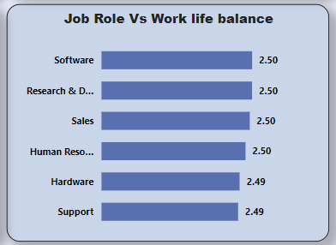
KPI 5 Job Role Vs Work Life Balance for Total Employees
This KPI is to find out the Work life balance for total Employees on the basis Job Role.
Insights from KPI 5:
From the analysis we can conclude that, For Research directors and the laboratory technicians the work life balance is poor.
For the Sales representatives , managers , Manufacturing Directors and the Sales executives the work life balance is fair.
For Research Scientists , Healthcare representatives und Developers the work life balance is good.
For human resources the work life balance is excellent.

Slide 11
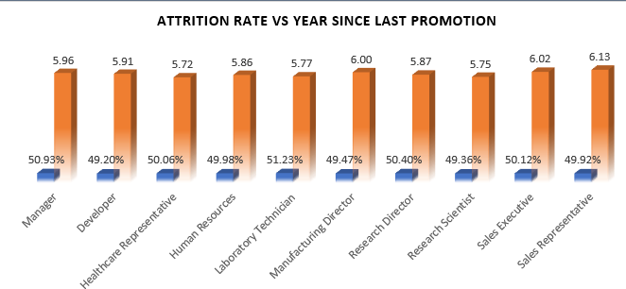
KPI 6 Attrition Rate Vs Years Since Last Promotion
This KPI is to find out the relation between Attrition rate vs Years since last Promotion
Insights from KPI 6:
For average years since Last year Promotion Sales Representative and Healthcare Representative has highest and lowest attrition rate respectively.

Slide 12
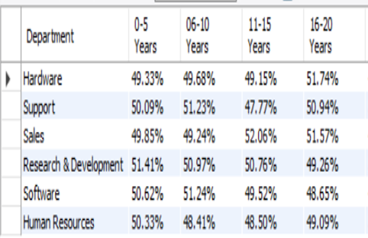
KPI 6 Attrition Rate Vs Years Since Last Promotion
This KPI is to find out the relation between Attrition rate vs Years since last Promotion
Insights from KPI 6:
For 0-5 years since Last year Promotion interval Research & Development and Hardware departments has highest and lowest attrition rate respectively.
For 6-10 years since last year promotion interval Human resources and software departments has highest and lowest attrition rate respectively.
For 11-15 years since last promotion interval support and sales departments has highest and lowest attrition rate respectively.
For 16-20 years since last promotion interval software & hardware departments has highest and lowest attrition respectively.

Slide 13
Conclusion :
Conduct stay interviews: Instead of exit interviews, conduct stay interviews with employees to gather feedback about the job.
Improve employee engagement: Implement initiatives to improve employee engagement, such as regular feedback, recognition and rewards programs, and opportunities for career growth.
Address workload issues: Ensure employees have manageable workloads by regularly monitoring and adjusting workloads to prevent burnout and overwhelm.
Create a positive work environment: Foster a positive work environment by promoting a culture of respect, inclusivity, and teamwork. Encourage open communication and collaboration among employees.
Address pay and compensation issues: Ensure that employees receive fair pay and compensation for their work and to find out what motivates an employee to continue to work in an organization.

Slide 14
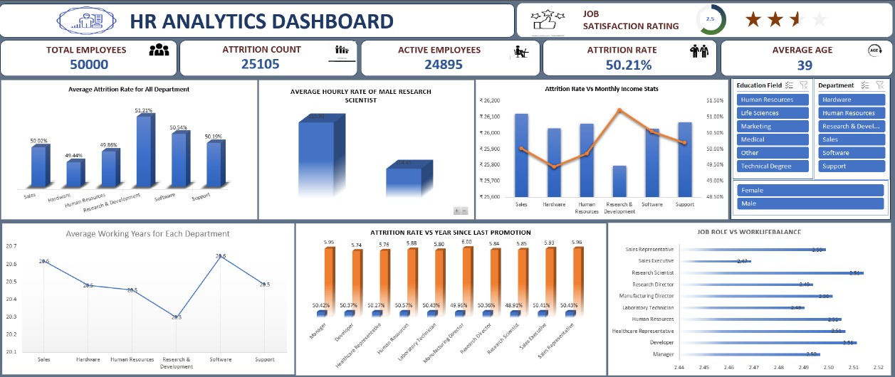
Excel Dashboard Screenshot

Slide 15
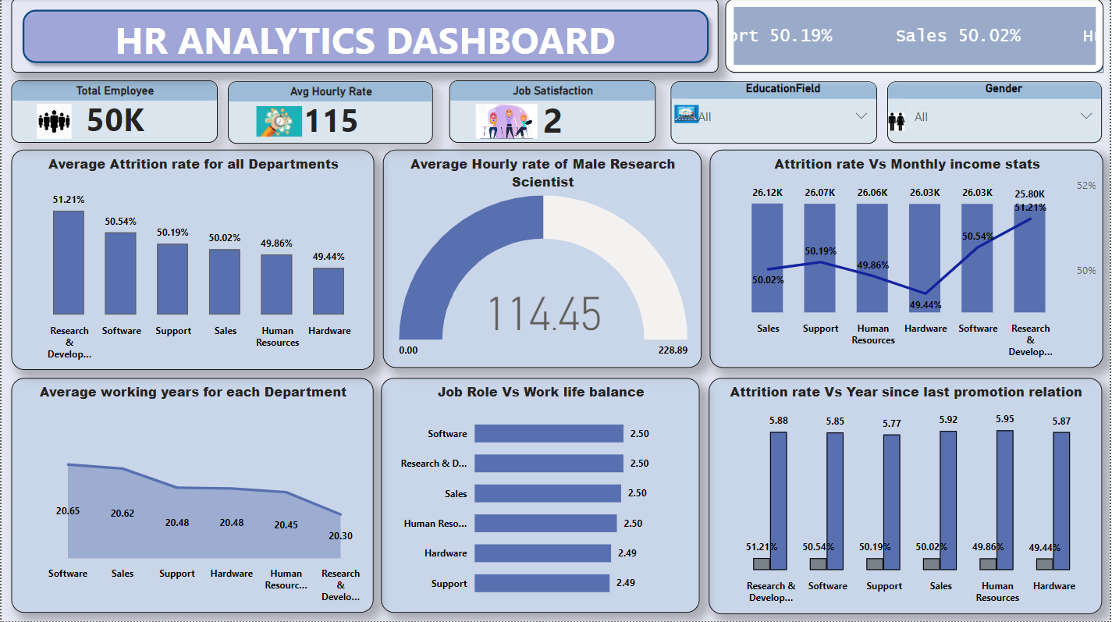
PowerBI Dashboard Screenshot

Slide 16
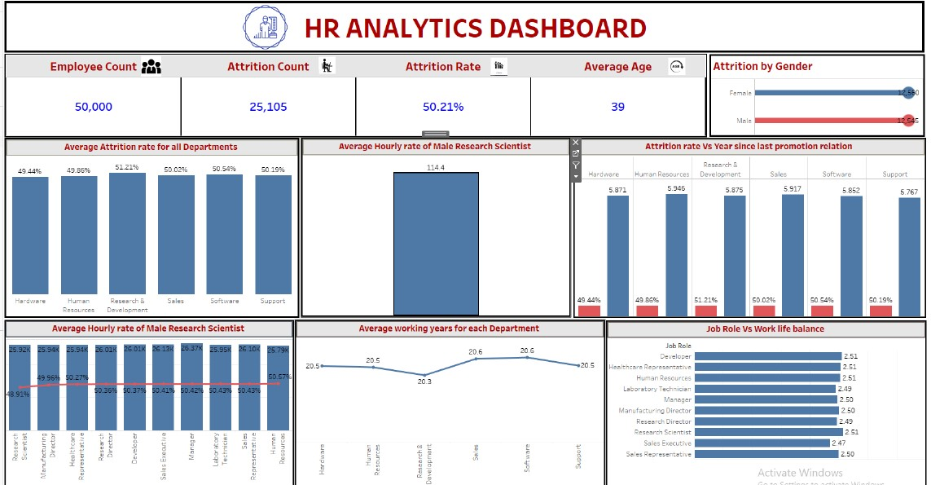
Tableau Dashboard Screenshot

Slide 17

HR Analytics

